Slide 1

Astrostats
Rashaad Reid

Slide 2
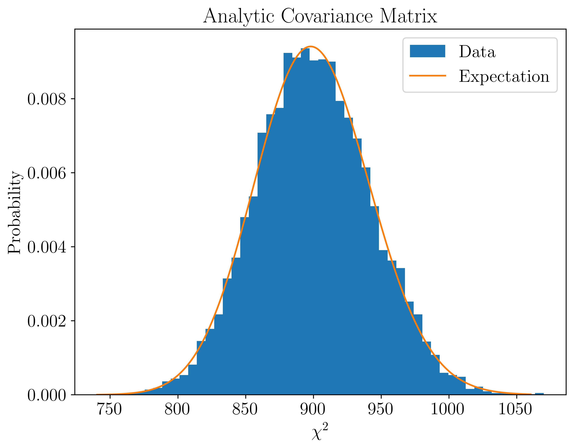
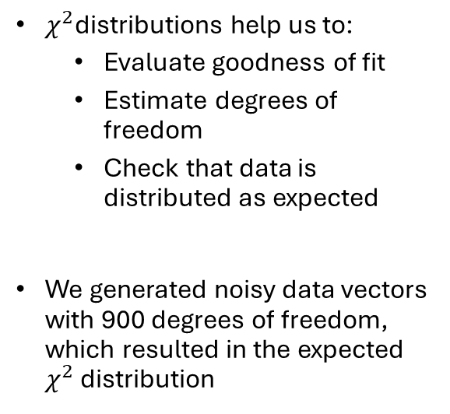
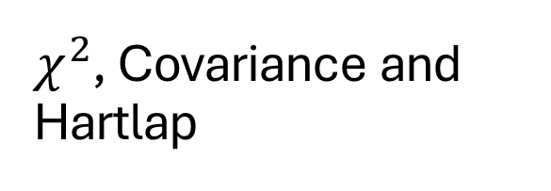
$χ^{2}$, Covariance and Hartlap
$χ^{2}$distributions help us to:
Evaluate goodness of fit
Estimate degrees of freedom
Check that data is distributed as expected
We generated noisy data vectors with 900 degrees of freedom, which resulted in the expected $χ^{2}$ distribution

Slide 3
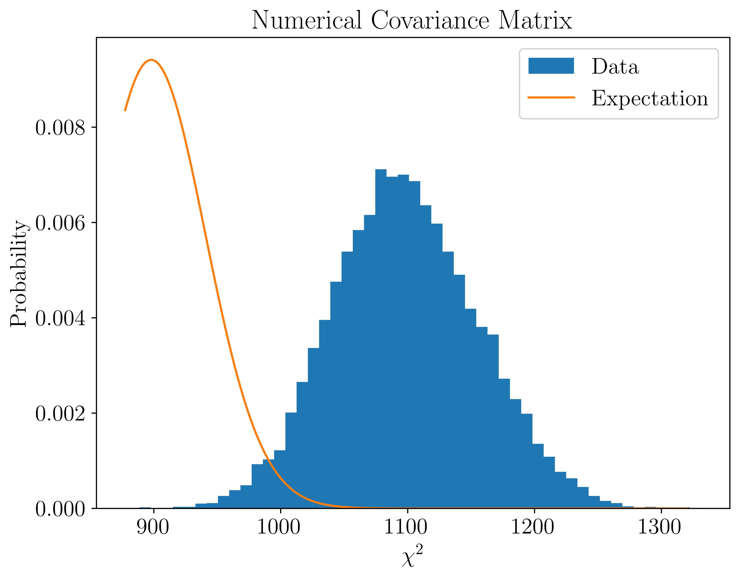
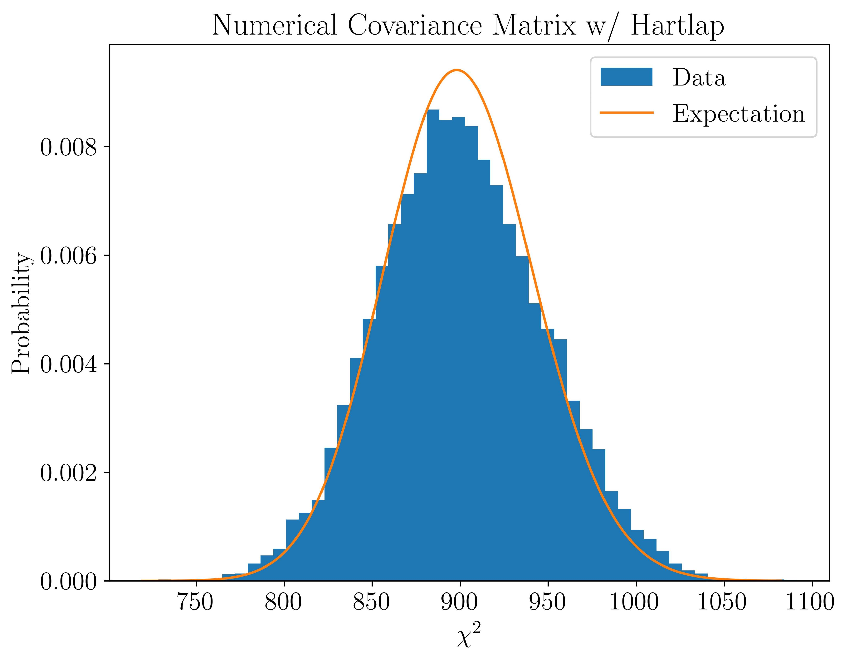
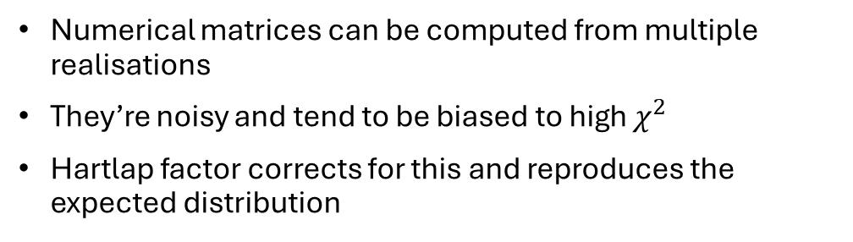
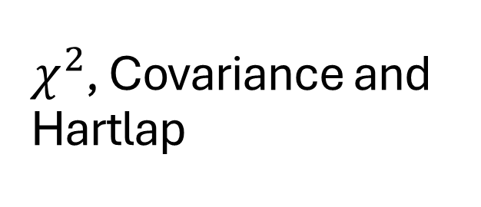
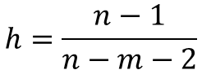
$χ^{2}$, Covariance and Hartlap
Numerical matrices can be computed from multiple realisations
They’re noisy and tend to be biased to high $χ^{2}$
Hartlap factor corrects for this and reproduces the expected distribution
$$h=\frac{n−1}{n−m−2}$$

Slide 4
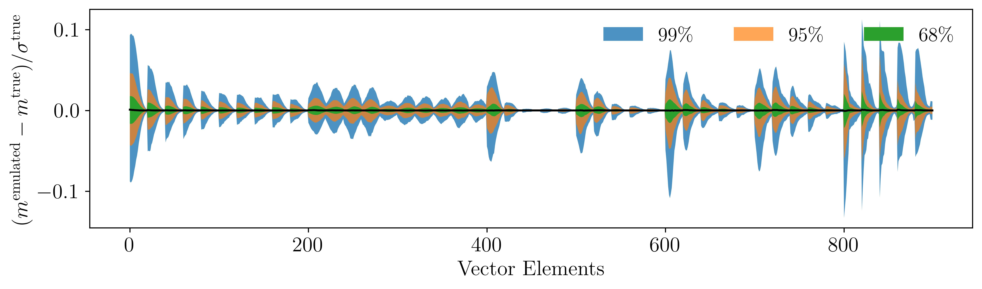
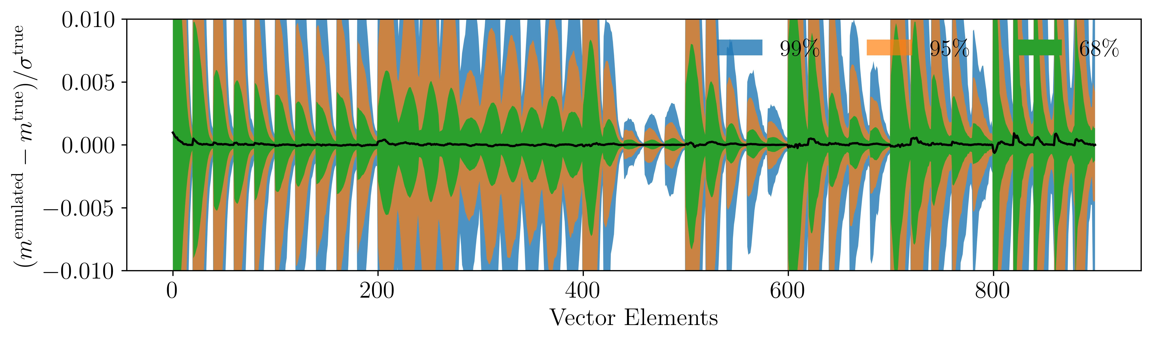
Neural Network & PCA
Neural network emulators can be trained to model functions
This allows for fast generation of realisations without the need for simulation
We trained an emulator on sample vectors and got these results on a training set

Slide 5
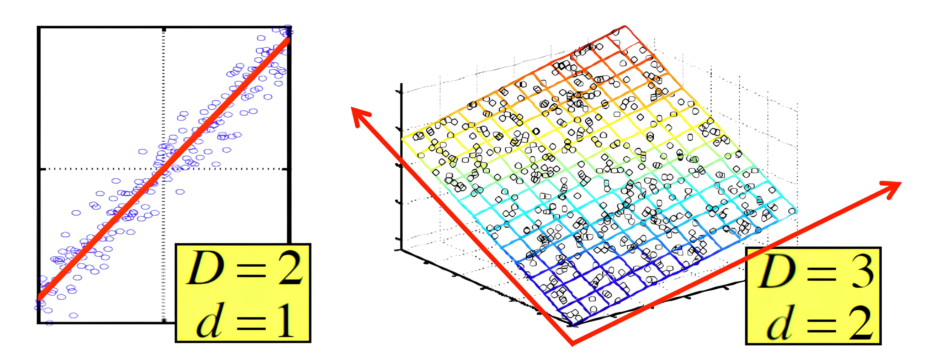

Neural Network & PCA
PCA analysis compresses data by reducing its dimension
Makes it easier to work with large data sets
Picks out important information
PCA is easier to implement than some other compression (like MOPED) since it doesn’t require assumptions about data

Slide 6
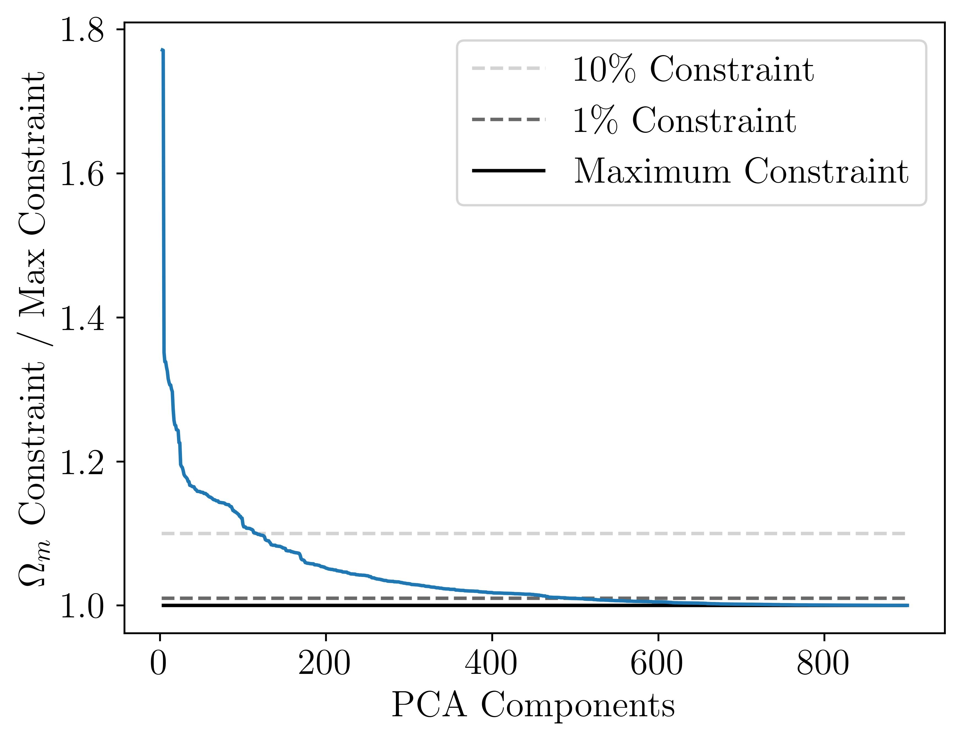
Neural Network & PCA
We used PCA compression and compared the parameter constraints to those from the raw data
Fewer PCA elements means more information loss
The dimension of the data can be cut in half while getting within 1% of maximum constraining power

Slide 7
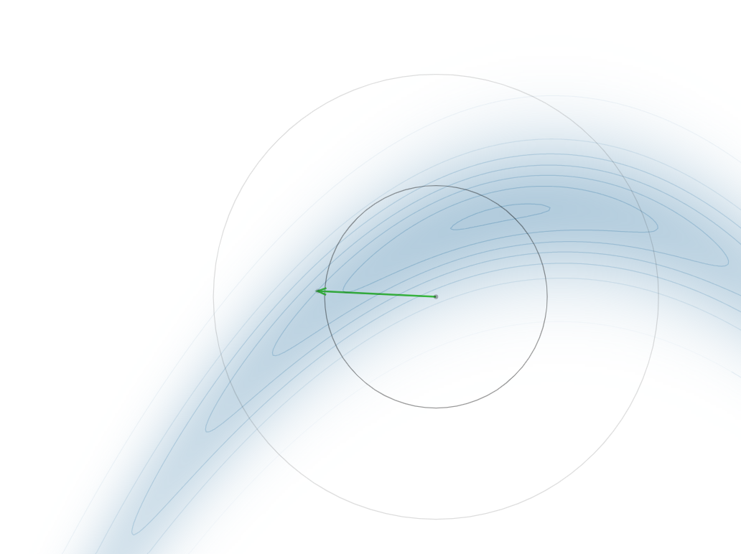
Monte-Carlo
MCMC has walkers take random steps in the parameter space to sample the posterior distribution
The Python package “emcee” uses a modified Metropolis-Hastings algorithm
It’s optimized for many walkers with few steps

Slide 8
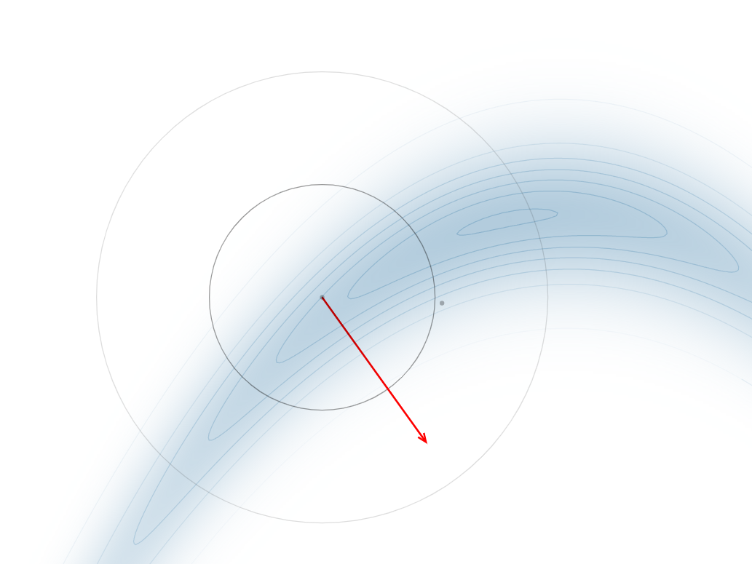
Monte-Carlo
MCMC has walkers take random steps in the parameter space to sample the posterior distribution
The Python package “emcee” uses a modified Metropolis-Hastings algorithm
It’s optimized for many walkers with few steps

Slide 9
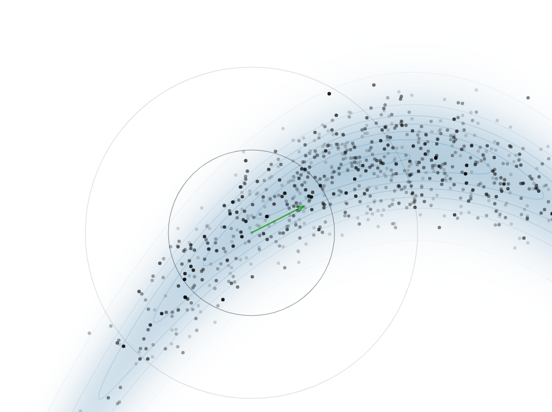
Monte-Carlo
MCMC has walkers take random steps in the parameter space to sample the posterior distribution
The Python package “emcee” uses a modified Metropolis-Hastings algorithm
It’s optimized for many walkers with few steps

Slide 10
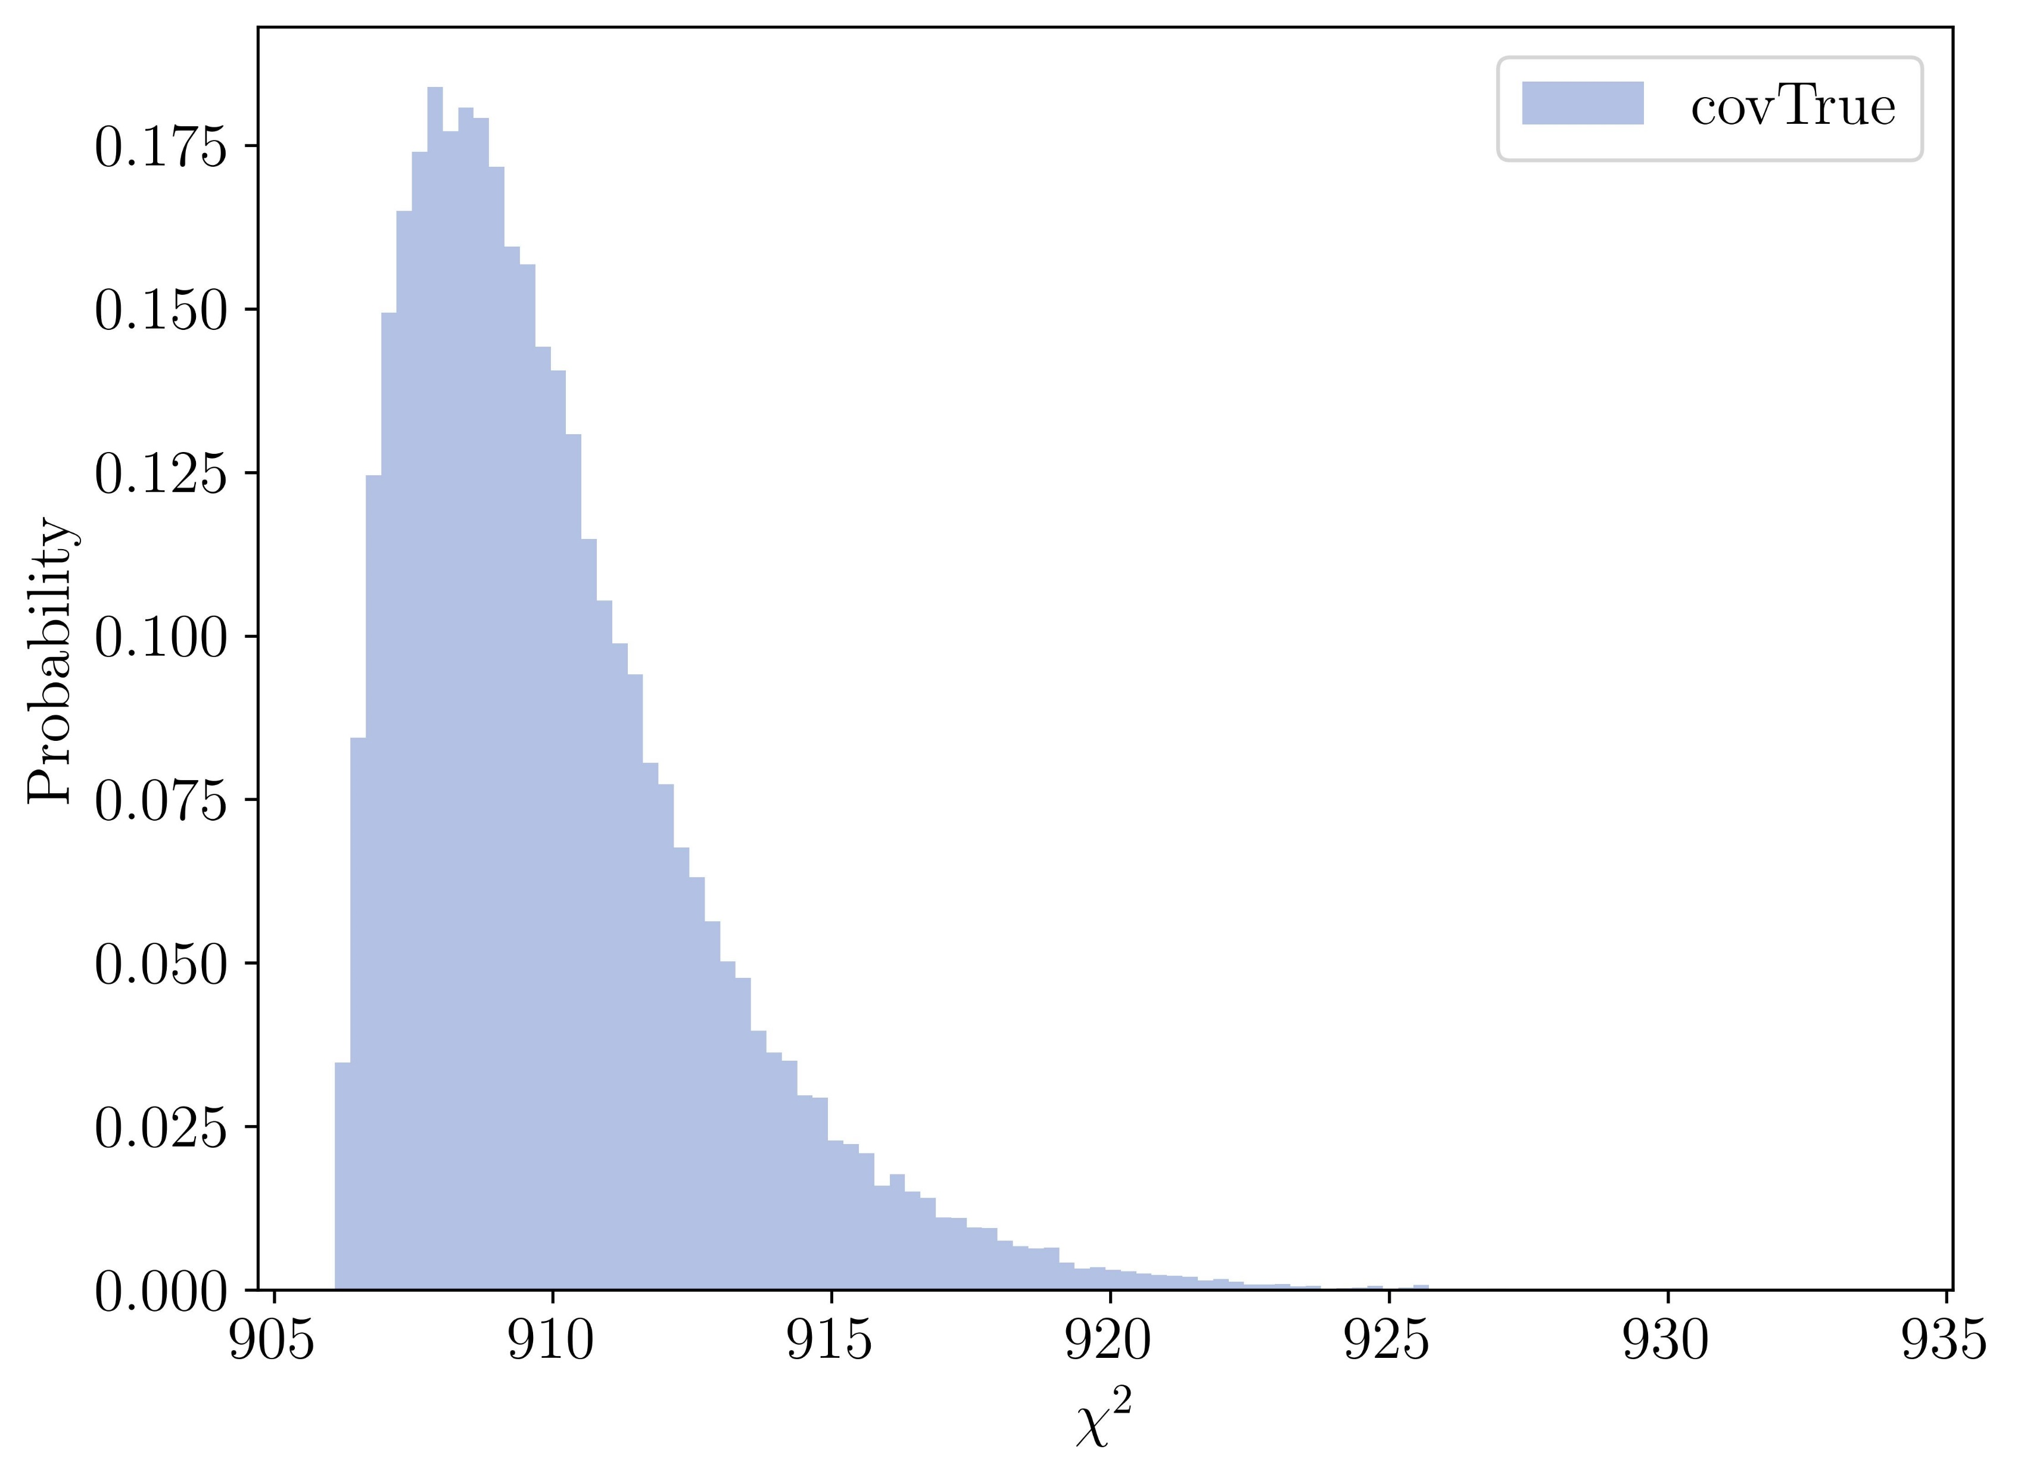
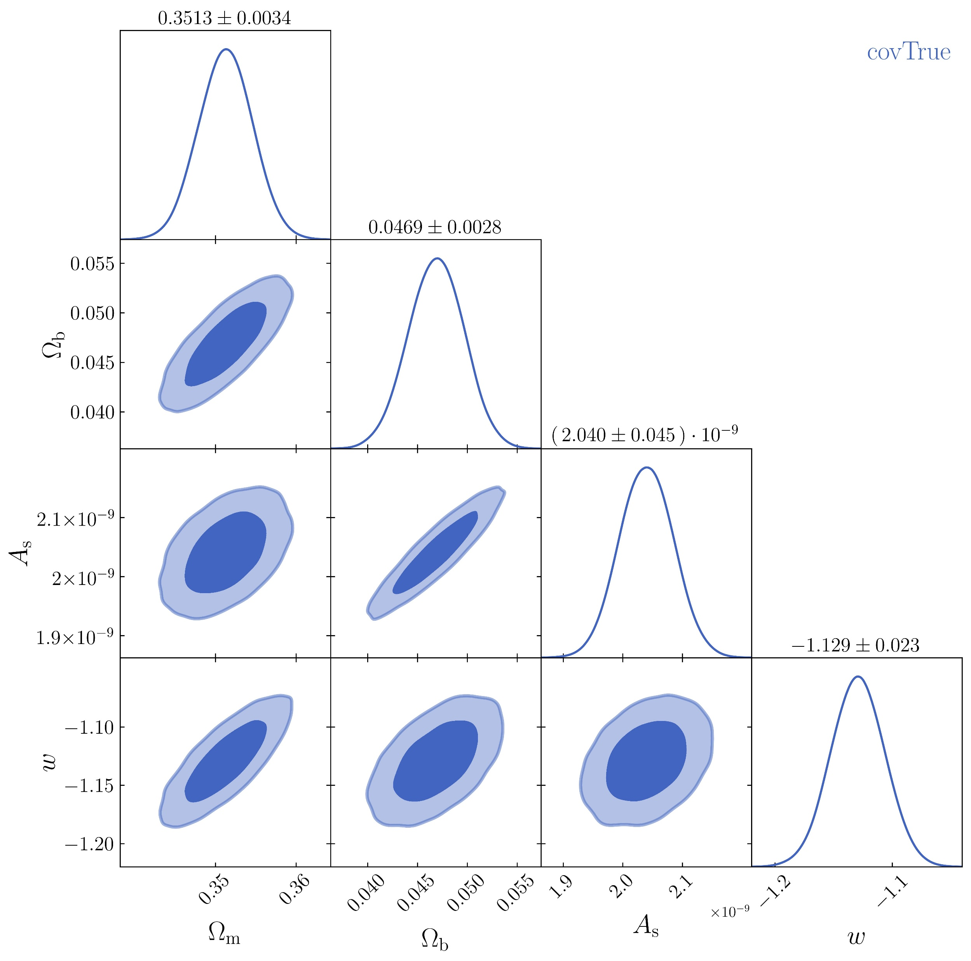
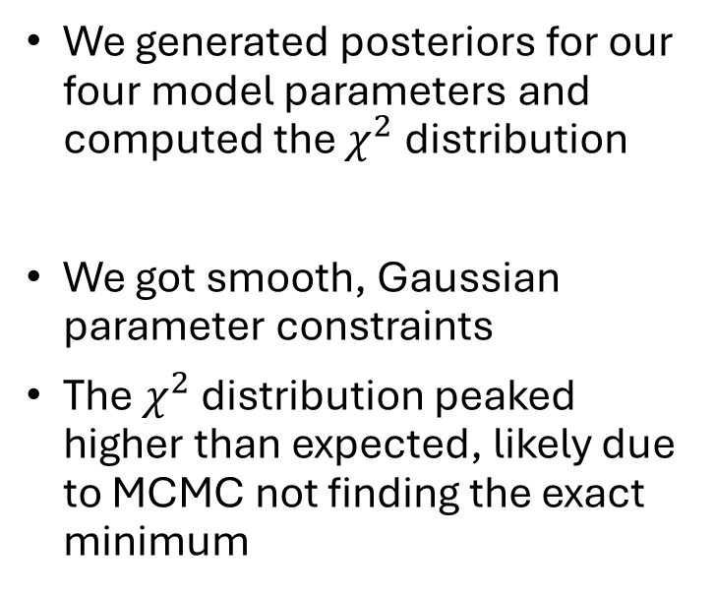
Monte-Carlo
We generated posteriors for our four model parameters and computed the $χ^{2}$ distribution
We got smooth, Gaussian parameter constraints
The $χ^{2}$ distribution peaked higher than expected, likely due to MCMC not finding the exact minimum

Slide 11
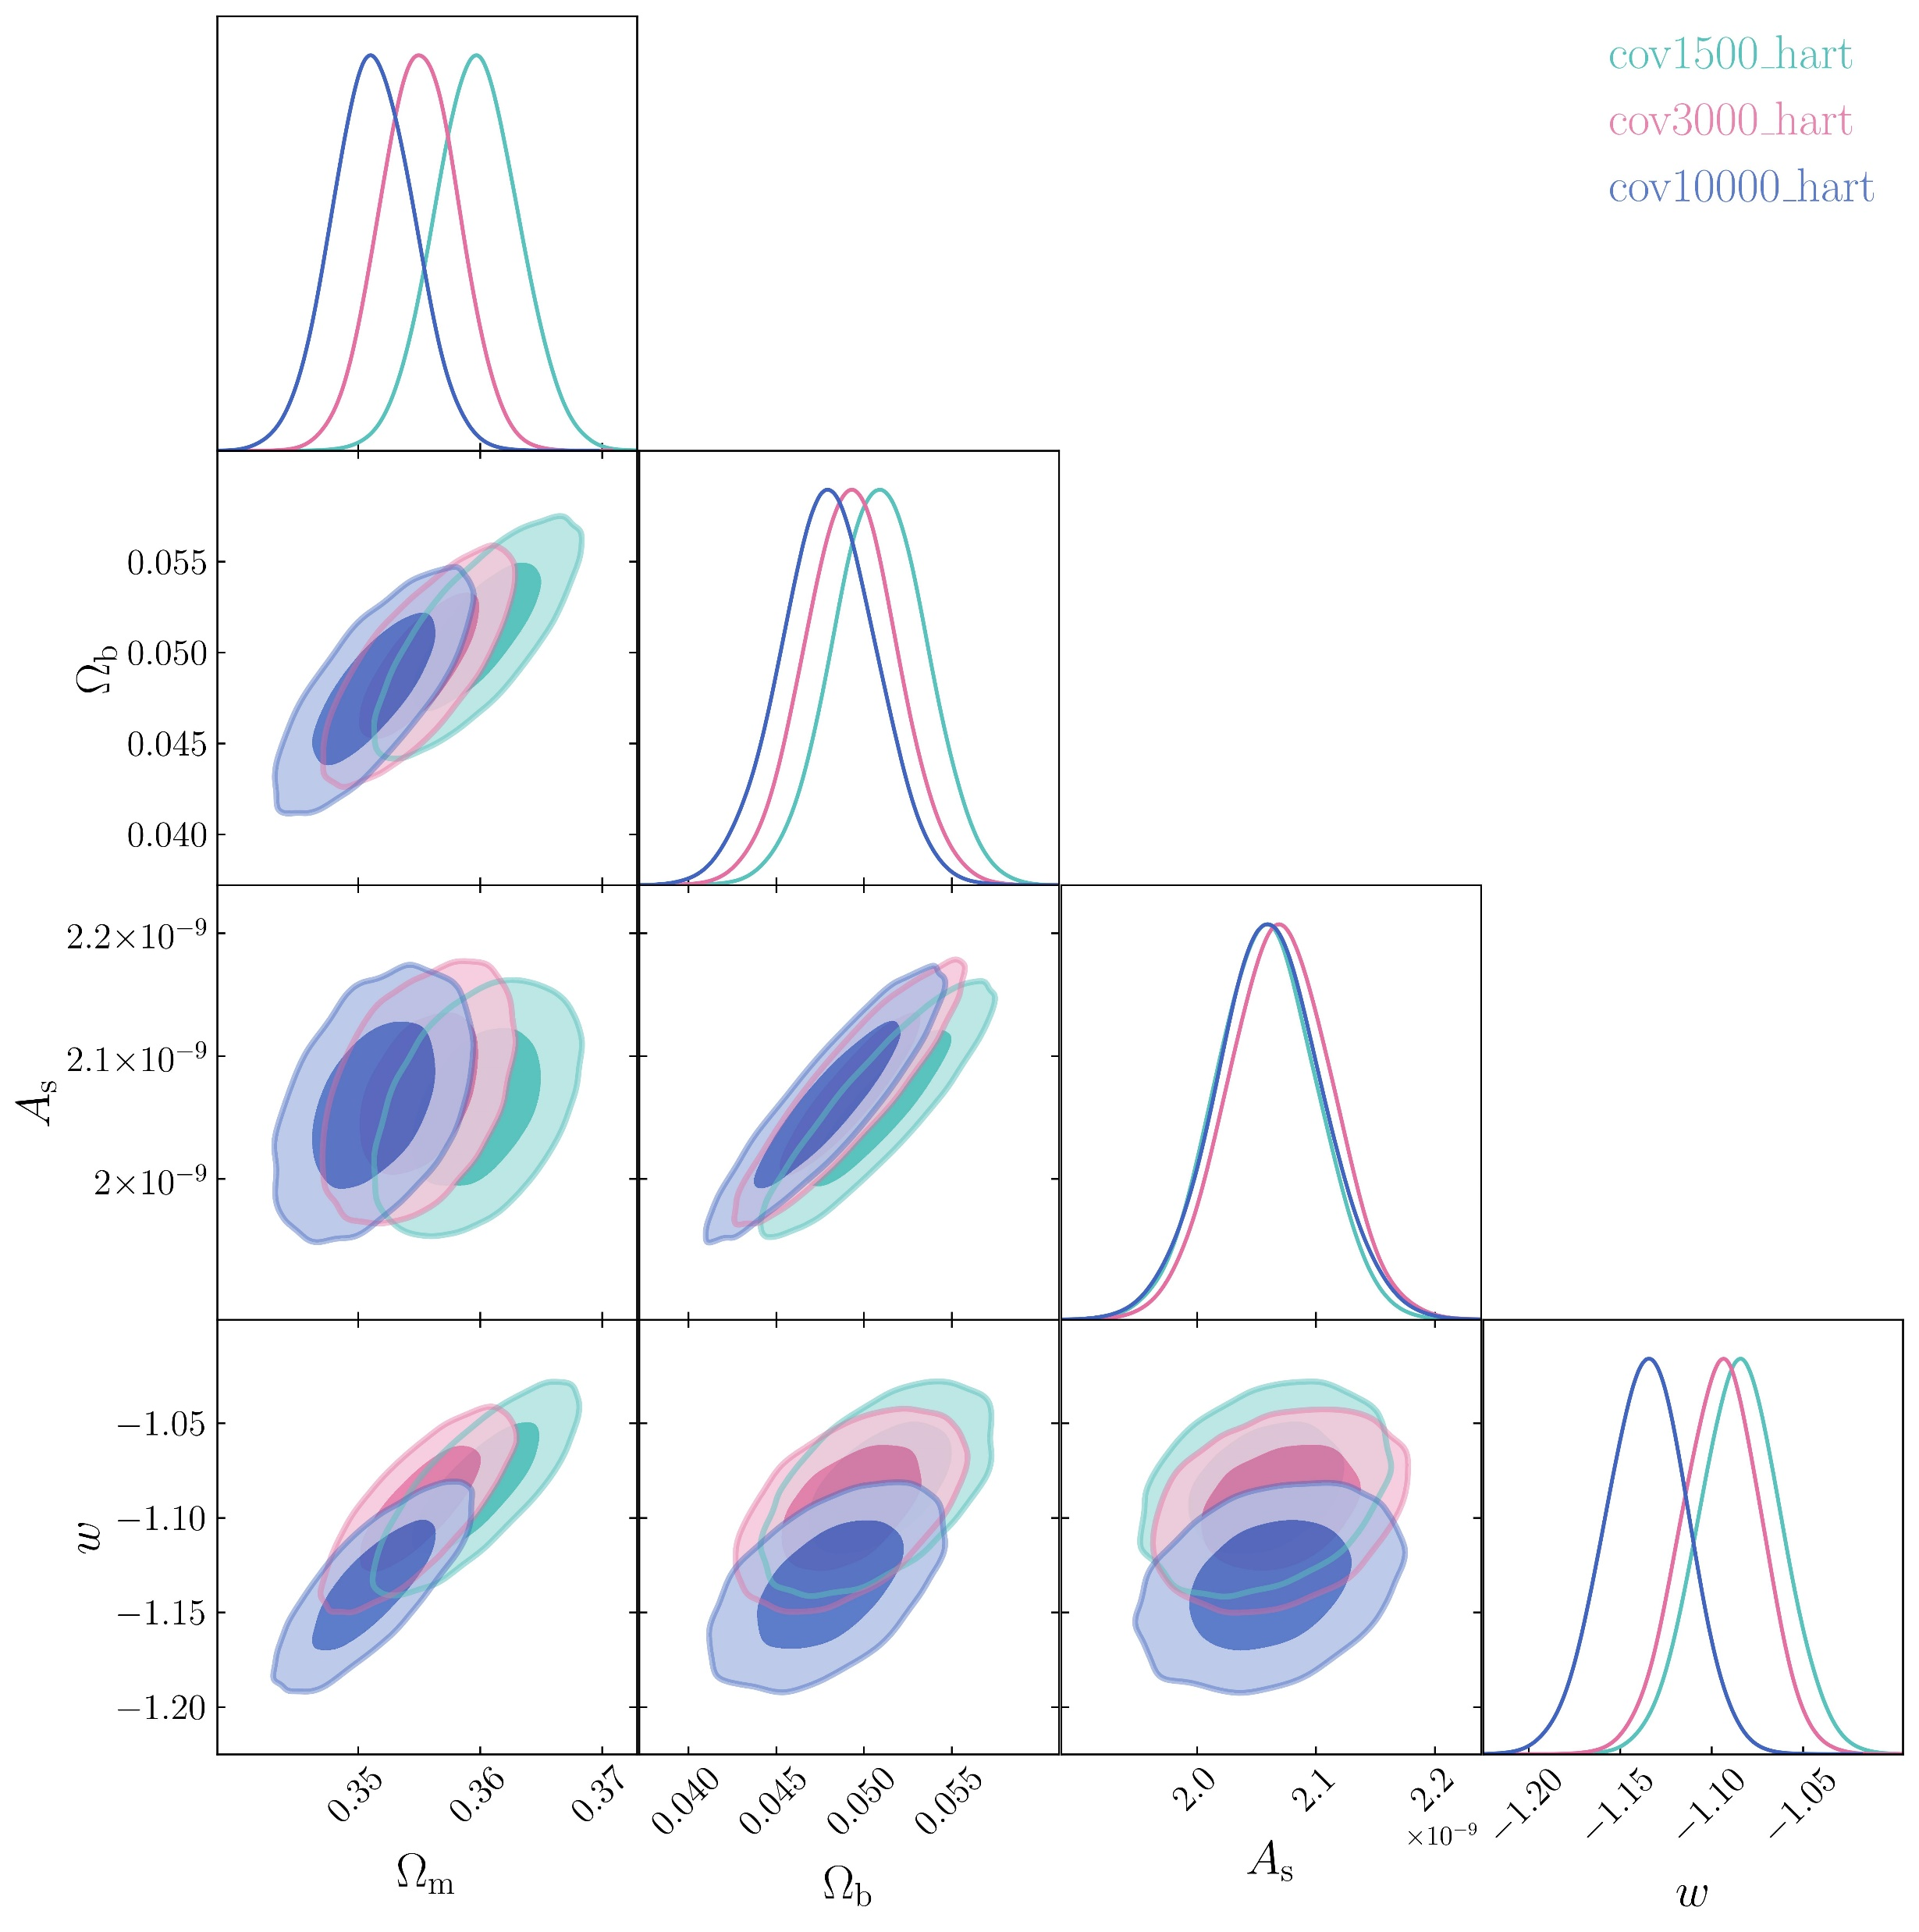
Monte-Carlo
Numerical covariance matrices generated from different numbers of realisations produce different constraints
Noise in covariance matrices matters, even with the Hartlap correction

Slide 12
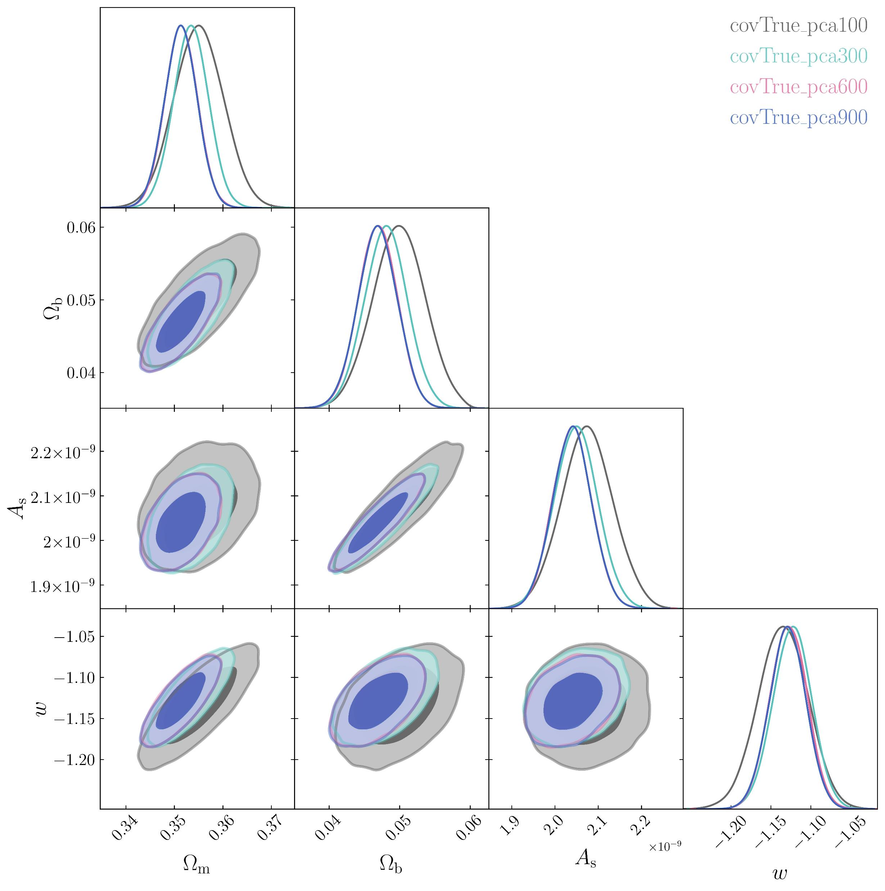
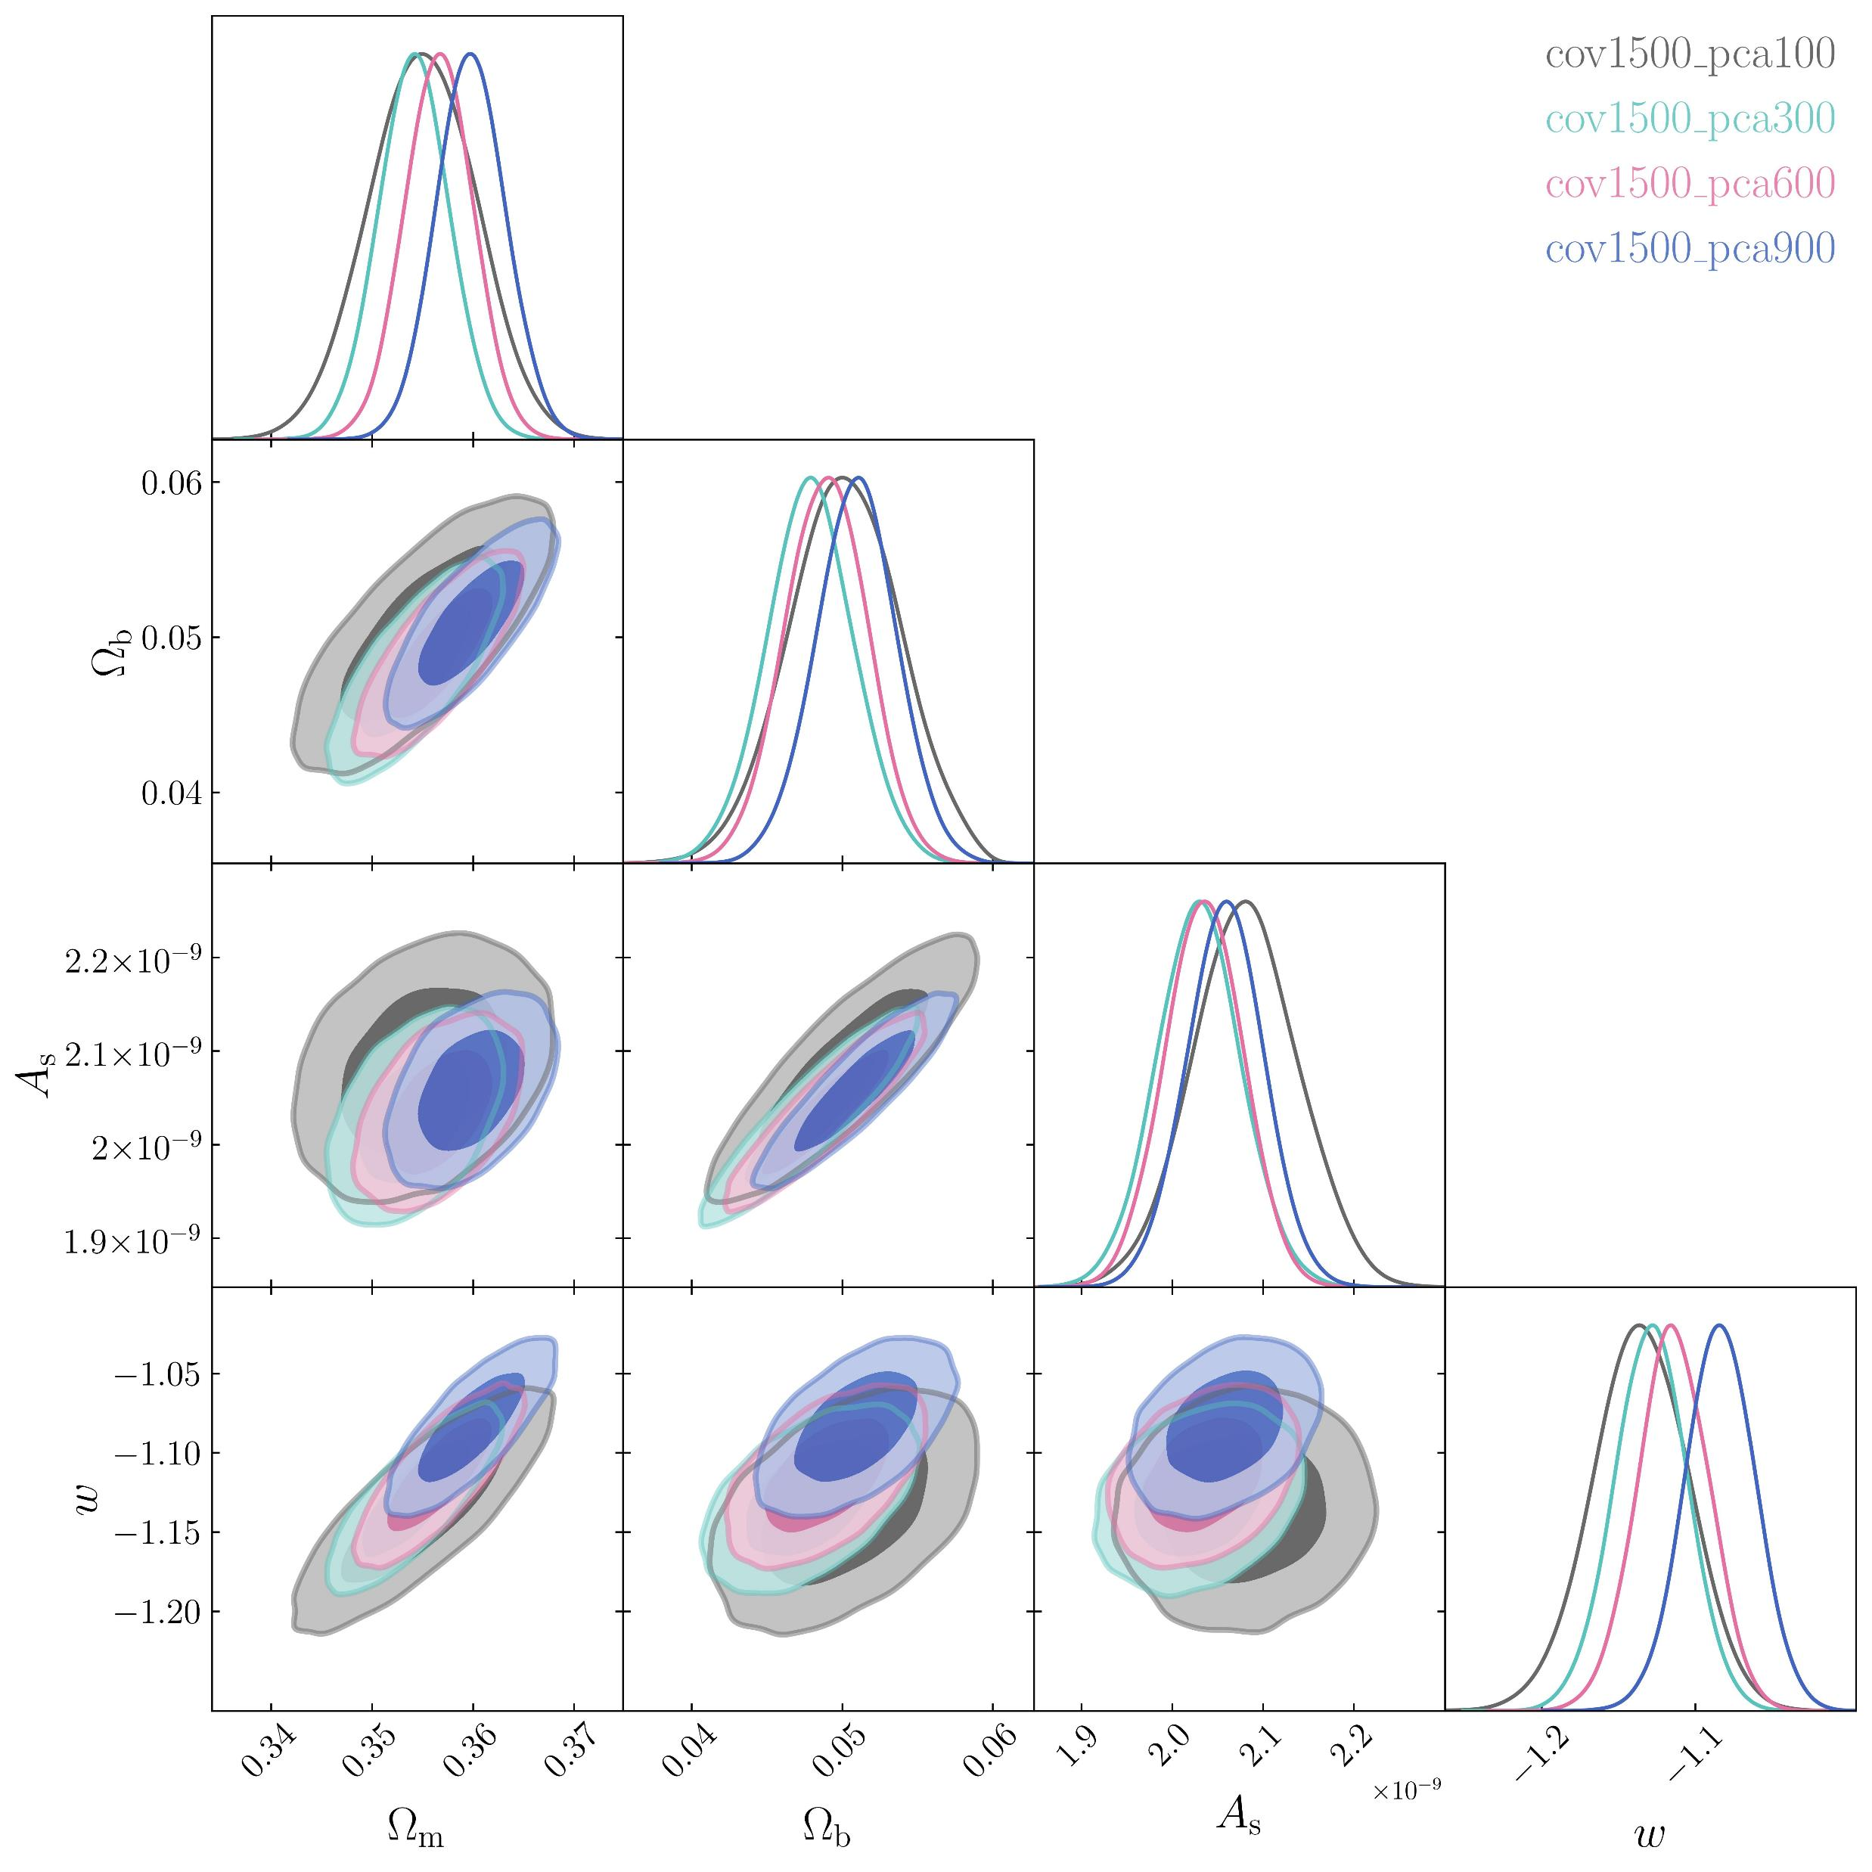
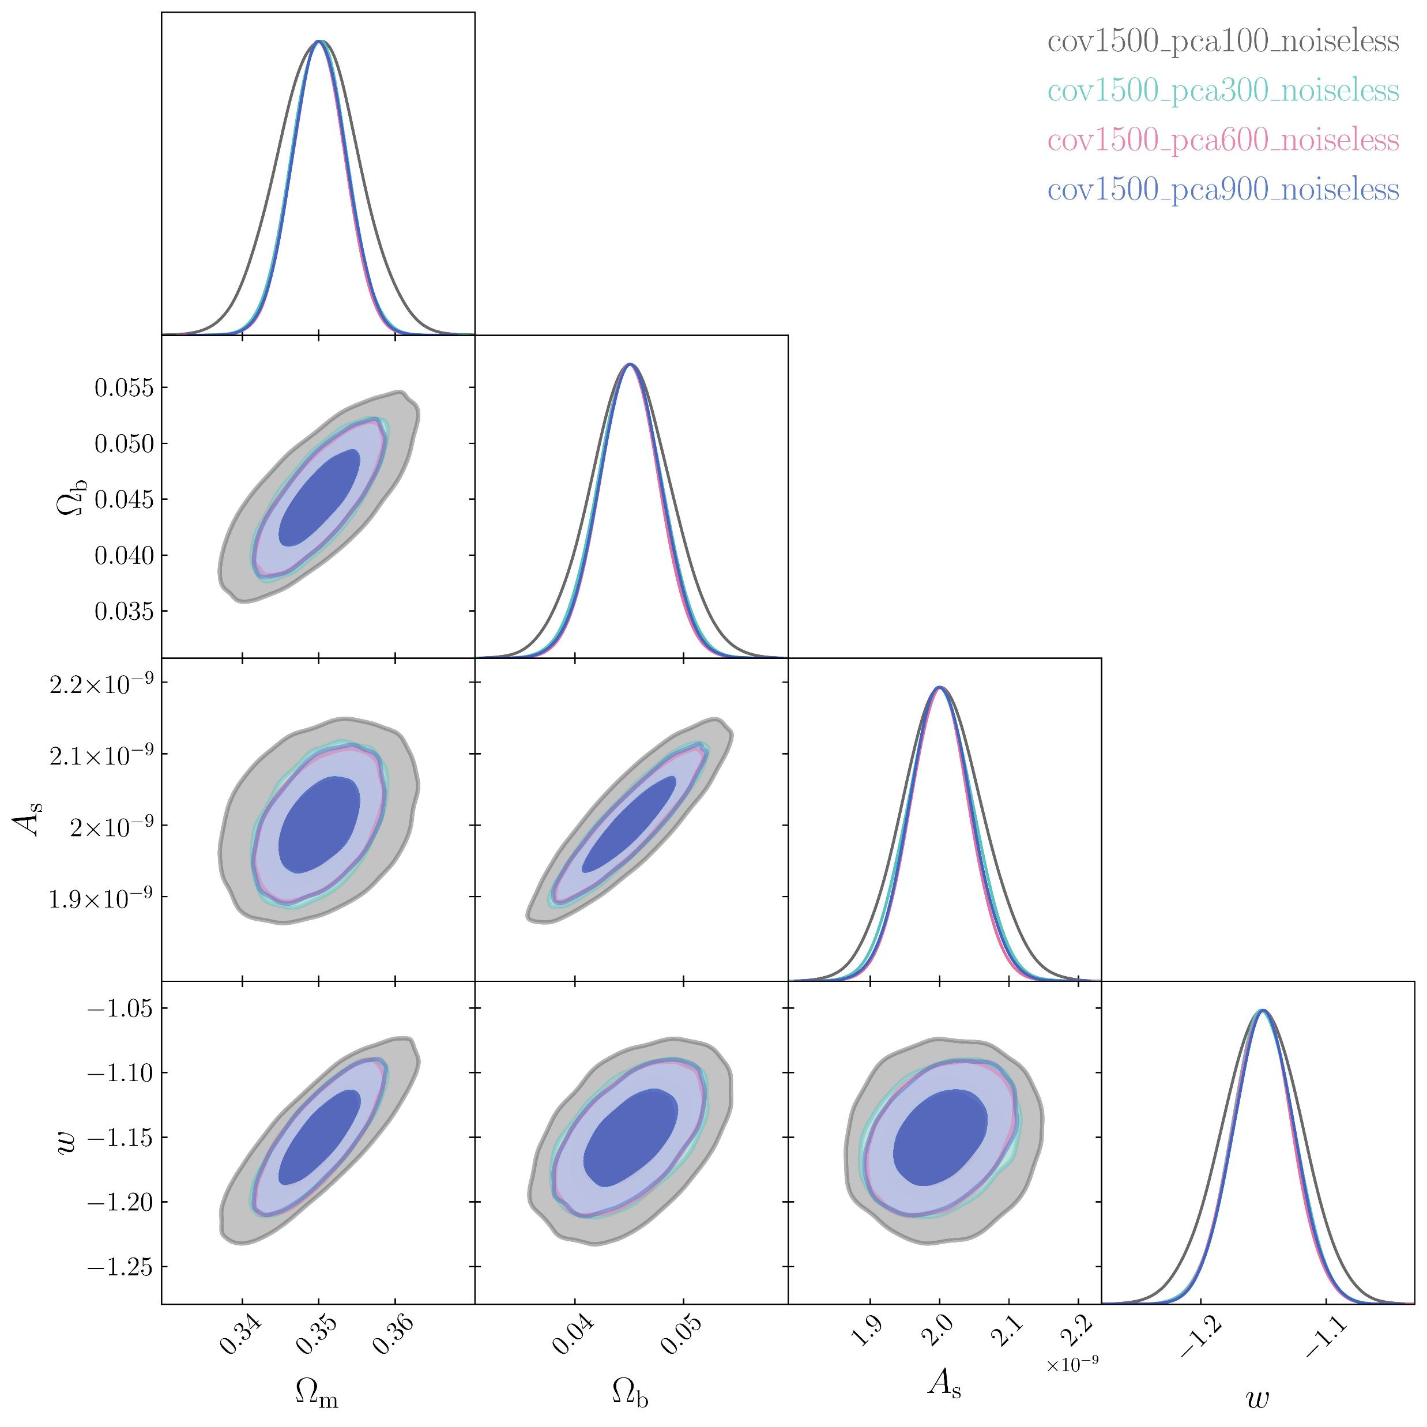
Monte-Carlo
Using more PCA elements gives tighter constraints
Having a numerical covariance matrix makes PCA less reliable
PCA is very effective for noiseless models

Slide 13
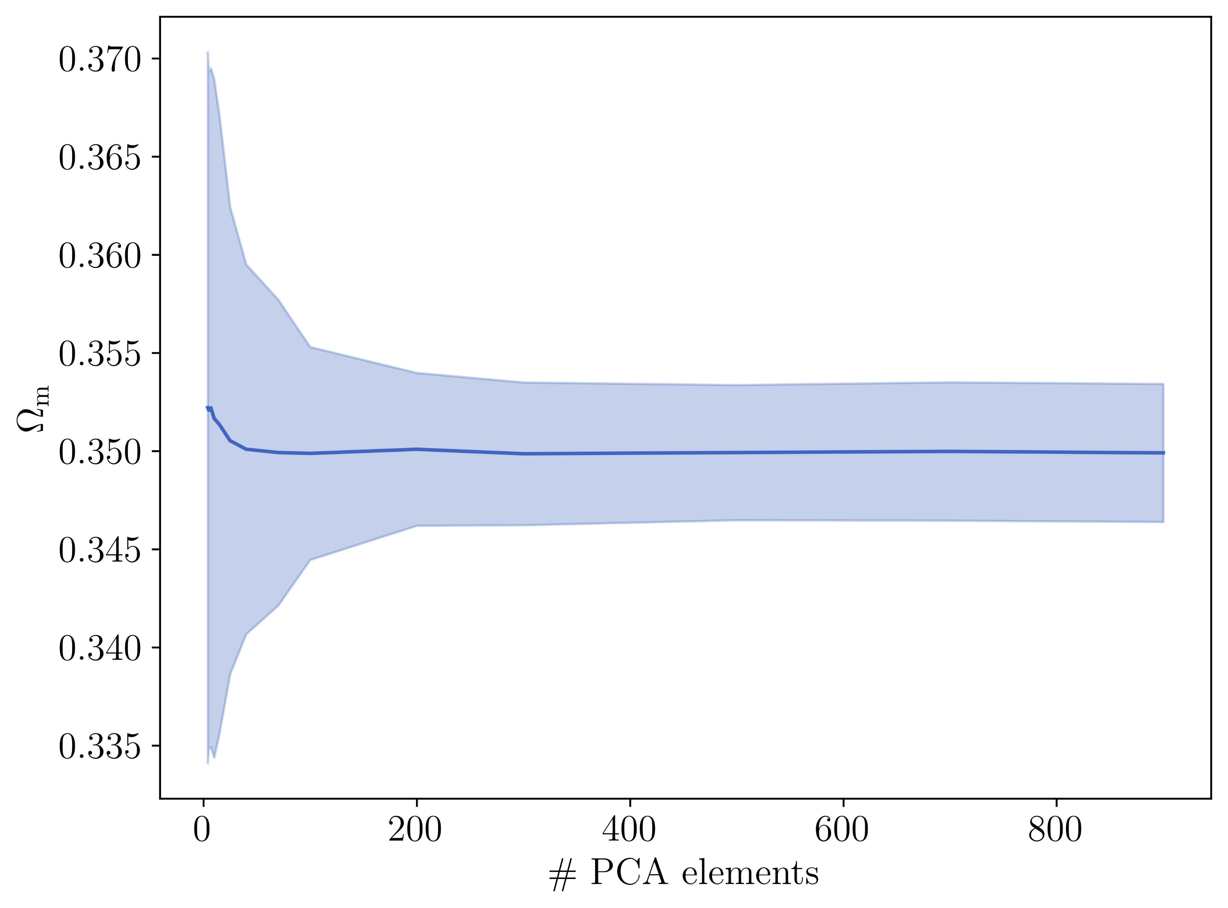
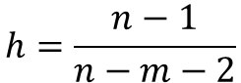
Monte-Carlo
$$h=\frac{n−1}{n−m−2}$$
Constraints are poor for very few PCA elements
You get diminishing returns when adding more PCA elements
There’s a minimum constraint around 500 elements
More elements means less info loss from PCA, but larger Hartlap correction

Slide 14

Monte-Carlo
$$h=\frac{n−1}{n−m−2}$$
Constraints are poor for very few PCA elements
You get diminishing returns when adding more PCA elements
There’s a minimum constraint around 500 elements
More elements means less info loss from PCA, but larger Hartlap correction

Slide 15
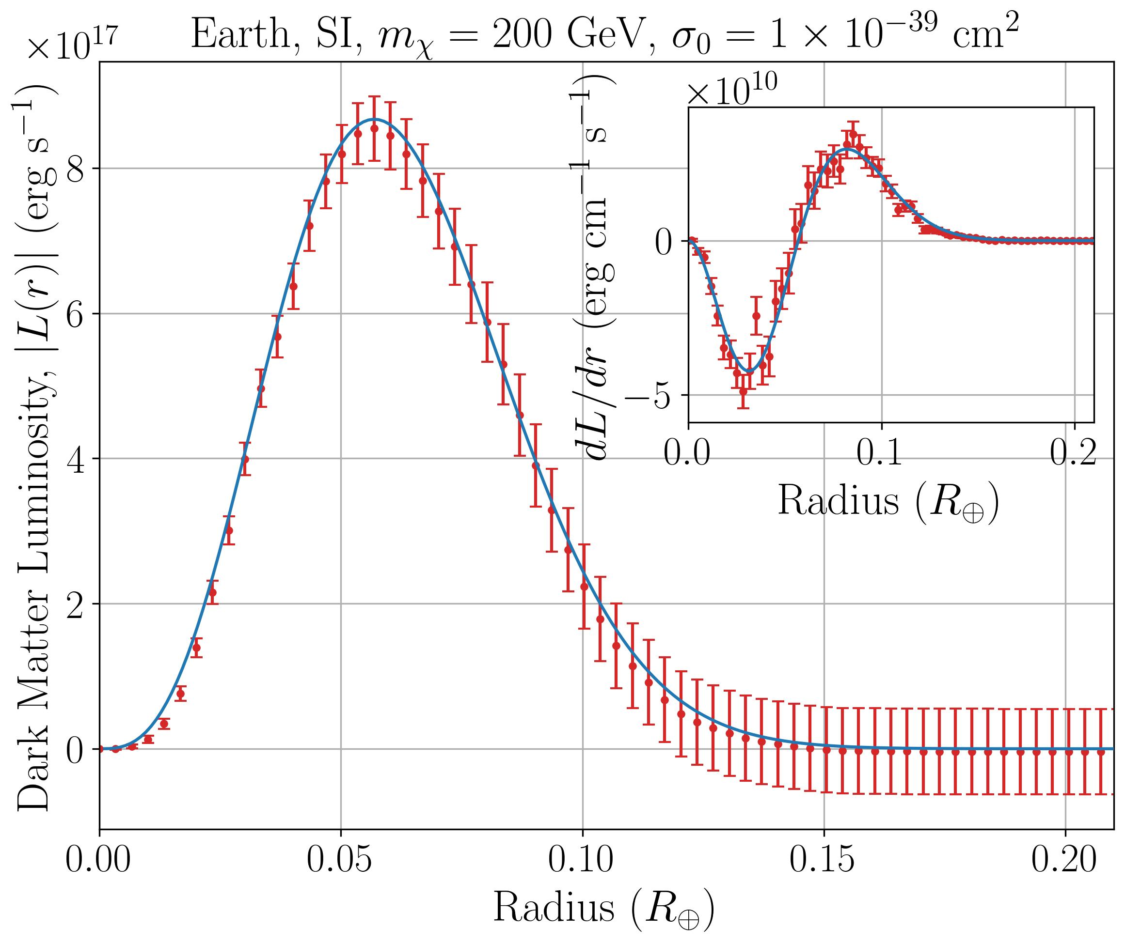
Future Research
Using simulations to generate vectors for different sets of parameters
Fitting analytic model parameters to simulated data
→ emulator
→ MCMC

Slide 16
Thank you

